Slide 1
JAVA PROJECT BATCH
GUI Programming
Lecture 7

Slide 2
Table Of Contents
01.
Using JRadio Button.
02.
Handling JRadioButton Event.
03.
JComboBox component.
04.
Methods of JComboBox.
05.
Handling JComboBox Event.

Slide 3


Using JRadio Button
Radio buttons in java are GUI controls which are use to accept a single option amongs multiple choices from the user ,i.e. mutually exclusive by nature.
text: For setting the text on JButton.
icon: For setting image on JButton.
font: For changing font of the JButton.
background: For changing the background color of JButton.
foreground: For changing the font color of JButton.
selected: For changing the initial state of JRadioButton to selected or deselected.
buttongroup: For making radio buttons manually exclusive.

Slide 4
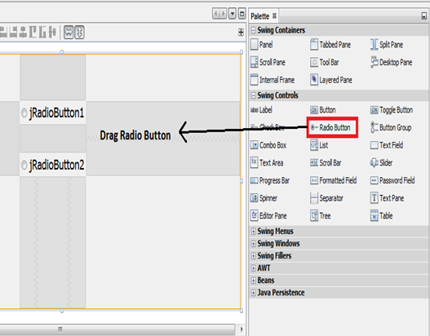
Practical Implementation Of ButtonGroup
In order to create grouped JRadioButtons with ButtonGroup one should follow these steps:
Drag and drop a panel onto your form. Then locate the Radio Button control in the
NetBeans palette. Drag a Radio button onto your new palette. It should look like
this:

Slide 5
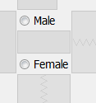
Practical Implementation Of ButtonGroup
2. The default text for the first radio button is jRadioButton1. We'll use our radio buttons to allow a user, so change the text of your radio button to Male.
3. Add one more radio button to the panel. Change the text to Female:

Slide 6
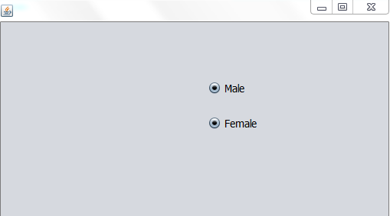
Practical Implementation Of ButtonGroup
4. There is, however, a problem with the radio buttons you've just added. To see what
the problem is, run your programme again. Now select one of the radio button. Try
selecting another radio button and you'll find that you can indeed select more than one
at the same time:

Slide 7
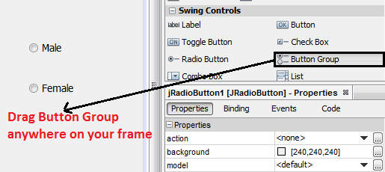
Practical Implementation Of ButtonGroup
5. With our radio buttons, though, we only want the user to select one option. To solve
the problem, Java lets you to create something called a ButtonGroup. As its name
suggests, this allows you to group buttons under one name. You can then add radio
buttons to the group.

Slide 8
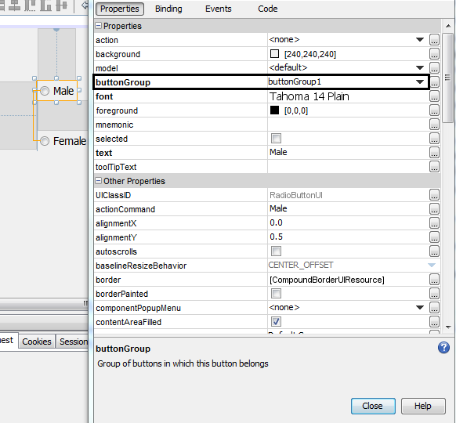
Practical Implementation Of ButtonGroup
6. Then select the Male radio button make a right click and go to the Properties
window on the bottom right corner. There you will see buttonGroup property the
choose the element name as buttongroup1. Now Male becomes a part of button
Group1.

Slide 9
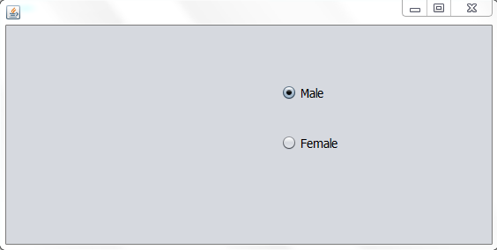
Practical Implementation Of ButtonGroup
7. Do the same process for Female radio button also. Put the Female radio button in the same buttonGroup1. Then Male and Female radio buttons automatically becomes mutually exclusive. At a time only one is on.

Slide 10
Making "JRadioButton" Objects Mutually Exclusive
By default "JRadioButton" objects are not mutually exclusive i.e. when we select the next radio button the previously selected radio button doesn't get deselected.
To change this behaviour we need to put "JRadioButton" objects into a common
group.
This group is formed using a "ButtonGroup" object. "ButtonGroup" is a class and all
the "JRadioButton" objects added to the same"ButtonGroup" become "Mutually
Exclusive".
To add "JRadioButton" to "ButtonGroup" we have to do two things:
Drag a ButtonGroup object on frame.
Set the Button Group property of JRadioButton to the ButtonGroup object .

Slide 11
Handling JRadioButton Event
Events Fired In JRadioButton:
A "JRadioButton" object fires the same event as a "JButton" object i.e.
ActionEvent so we have to override the method "actionPerformed( )" and
event handling is done same as we do in "JButton“.

Slide 12
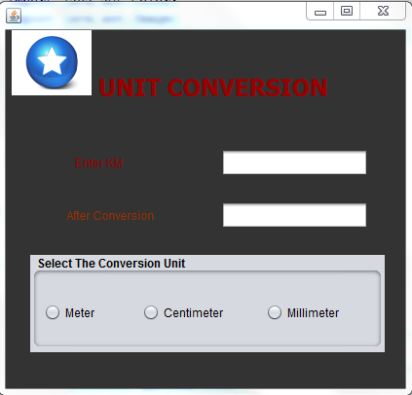
Example
Develop an application containing two text field and three radio buttons titled
Meter, Centimeter and Killometer. As the user selects these radio buttons apply the
required output on the another text field.

Slide 13
Example
private void myActionPerformed(java.awt.event.ActionEvent evt) {
String kmstr = txtKm.getText();
try
{
int km=Integer.parseInt(kmstr);
String result;

Slide 14
Example
if(evt.getSource()==jrMeter)
{
int meter=km*1000;
result=meter+" meters";
}
else if(evt.getSource()==jrCentimeter)
{
int cm=km*100000;
result=cm+" centimeters";
}

Slide 15
Example
else
{
int mm=km*1000000;
result=mm+" millimeters";
}
txtResult.setText(result);
}
catch(NumberFormatException ex)
{
JOptionPane.showMessageDialog(null,"Please intput digits only","Conversion
Error!",JOptionPane.ERROR_MESSAGE);
txtKm.setText("");
txtKm.requestFocus();
}
}

Slide 16
The JComboBox Component
ComboBoxes are dropdown list which display a list of choices to the user and allow
him to select one element at a time.
Properties Of "JComboBox"
1. model:- For setting items to be displayed in the JComboBox
2. maximumrowcount:- For settings no of items to be displayed by default in the
JComboBox

Slide 17
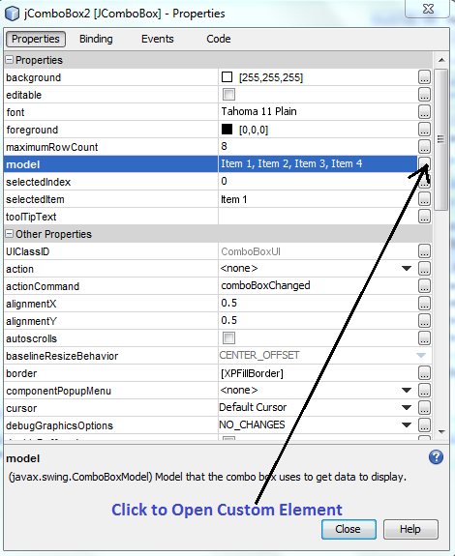
How To Add Elements At Design Time In ComboBox
Drag and drop Combo Box into your Frame.
Then select the Combo Box make a right click and go to the Properties window on
the bottom right corner. There you will see model property then click to open
custom editor.

Slide 18
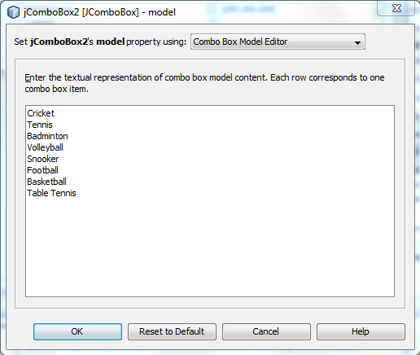
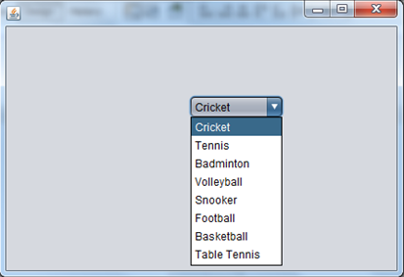
Adding Element At Design Time In Combobox
3. Now enter the textual representation of combo box model content.
4. Now run the code. It will look
like this:

Slide 19
Methods of JComboBox
Methods:
1. public void addItem(Object)
2. public void insertItemAt(Object,int)
3. public int getItemCount( )
4. public int getSelectedIndex( )
5. public void removeItemAt(int)
6. public void removeAllItems()
7. public Object getSelectedItem( )
8. public void setMaximumRowCount(int)

Slide 20
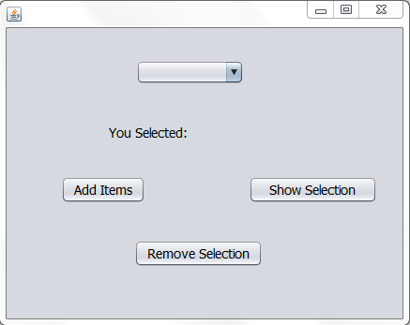
Handling JComboBox Event
Events Fired In JComboBox:
A "JComboBox" object fires the same event as a "JButton" object i.e. ActionEvent so we have to override the method "actionPerformed( )" and event handling is done
same as we do in "JButton“
Develop an application have the behavior as shown below:

Slide 21
Example Of ComboBox
Code:-
private void jButton1ActionPerformed(java.awt.event.ActionEvent evt)
{
String[] arr={"January","February","March","April","May","June","July","August"};
for(String s:arr)
{
jComboBox1.addItem(s);
}
}

Slide 22
Example Of ComboBox
private void jButton2ActionPerformed(java.awt.event.ActionEvent evt) {
try
{
String str=jComboBox1.getSelectedItem().toString();
jLabel1.setText("You Selected:"+str);
}
catch(NullPointerException e)
{
JOptionPane.showMessageDialog(null, "Please make a selection first");
}
}

Slide 23


